Slide 1
DBMS

Slide 2
Precedence of Relational Operators
1. [ σ, π, ρ] (highest).
2. [ Χ, ⋈]
3. ∩
4. [ ∪, — ]
26

Slide 3
Cartesian Product
The Cartesian product needs not to be union compatible
It means they can be of different degree
It is denoted by X
Suppose R and S are two relations
The Cartesian product will be:
R X S
It is also called cross product

Slide 4
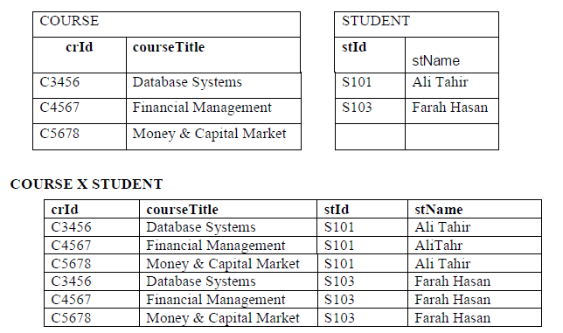
Cartesian Product Example

Slide 5
Cartesian Product Example
A = {small, medium, large}
B = {shirt, pants}
A X B | Shirt | Pants
Small | (Small, Shirt) | (Small, Pants)
Medium | (Medium, Shirt) | (Medium, Pants)
Large | (Large, Shirt) | (Large, Pants)
A x B = {(small, shirt), (small, pants), (medium, shirt), (medium, pants), (large, shirt), (large, pants)}
5

Slide 6
Example: Cartesian Product
What is the Cartesian Product of AxB ?
A = {perl, ruby, java}
B = {necklace, ring, bracelet}
What is BxA?
A x B | Necklace | Ring | Bracelet
Perl | (Perl,Necklace) | (Perl, Ring) | (Perl,Bracelet)
Ruby | (Ruby, Necklace) | (Ruby,Ring) | (Ruby,Bracelet)
Java | (Java, Necklace) | (Java, Ring) | (Java, Bracelet)
6

Slide 7
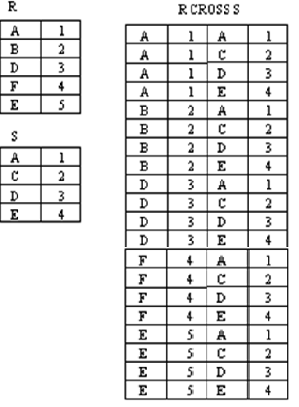
Another Example

Slide 8
Join Operations(⋈, ⟕, ⟖, ⟗)
The Join operation is used to compound similar tuples from two Relations into single longer tuples.
Join is a special form of cross product of two tables.
Join operation is generally a Cartesian product followed by a selection criterion.
In Cartesian product we join a tuple of one table with the tuples of the second table. But in join there is a special requirement of relationship between tuples.
Join operation denoted by ⋈.

Slide 9
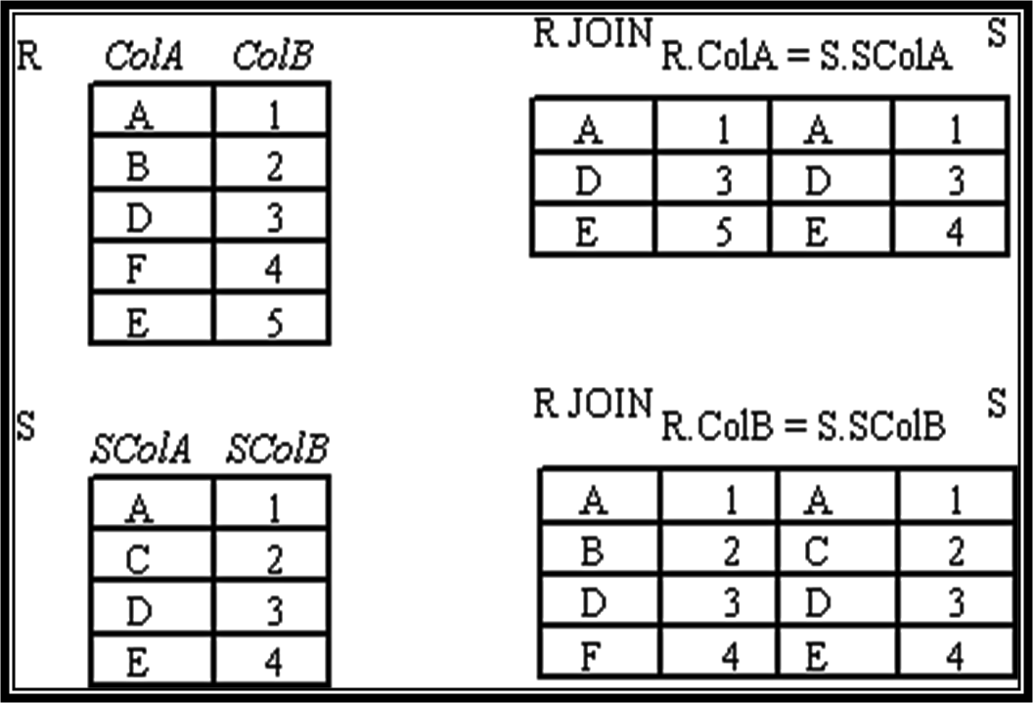
Simple Example

Slide 10
Types of JOIN
Inner Joins:
Theta join
EQUI join
Natural join
Outer join:
Left Outer Join
Right Outer Join
Full Outer Join

Slide 11

Inner Joins
In an inner join, only those tuples that satisfy the matching criteria are included, while the rest are excluded. Let's study various types of Inner Joins:
Theta Join
The general case of JOIN operation is called a Theta join.
It is denoted by symbol θ

Slide 12
Inner Joins
Theta Join
Consider tables Car and Boat which list models of cars and boats and their respective prices. Suppose a customer wants to buy a car and a boat, but she does not want to spend more money for the boat than for the car.
The θ-join (⋈_{θ}) on the predicate CarPrice ≥ BoatPrice produces the flattened pairs of rows which satisfy the predicate.

Slide 13
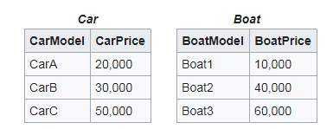
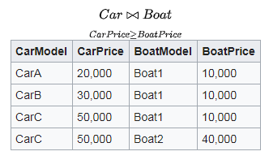
Inner Joins
Theta Join

Slide 14
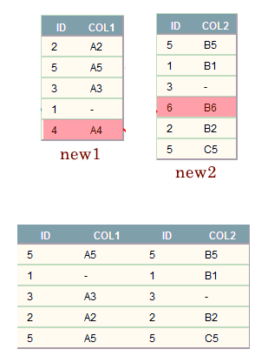
Inner Joins
EQUI join
When a theta join uses only equivalence condition, it becomes equi join.
For example:
new1 ⋈_{new1.id = new2.id} (new2)

Slide 15
Equijoin
SID | Name | Login | DoB | GPA
55515 | Smith | smith@ccs | Jan 10,1990 | 3.82
55516 | Jones | jones@hist | Feb 11, 1992 | 2.98
S1
S
S1.sid = C1.sid ^{C1}
C1
Sid | CId | Grad e
55515 | History 101 | C
55516 | Biology 220 | A
55517 | Anthro 320 | B
55518 | Music 101 | A
Only one copy of Sid is in the resultant relation
SID
Name
Login
DoB
GPA
CID
Grade
55515 Smith
smith@ccs
Jan 10,1990
3.82
History 101
C
55516 Jones
jones@hist
Feb 11, 1992
2.98
Biology 220
A

Slide 16
Inner Joins
NATURAL JOIN (⋈)
Natural join can only be performed if there is a common attribute (column) between the relations. The name and type of the attribute must be same.
Example
Consider the following two tables
C
Num | Square
2 | 4
3 | 9
D
Num | Cube
2 | 8
3 | 27

Slide 17
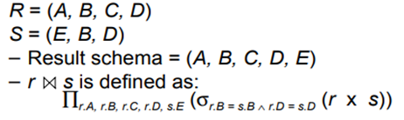
Inner Joins
NATURAL JOIN (⋈)
C ⋈ D
Num | Square | Cube
2 | 4 | 8
3 | 9 | 27
Another Example

Slide 18
Outer join
In an outer join, along with tuples that satisfy the matching criteria, we also include some or all tuples that do not match the criteria.
Left Outer Join(A B)
In the left outer join, operation allows keeping all tuple in the left relation. However, if there is no matching tuple is found in right relation, then the attributes of right relation in the join result are filled with null values.

Slide 19
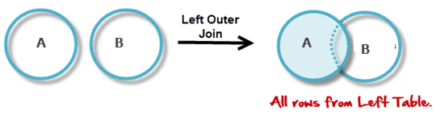
Outer join
Left Outer Join(A B)

Slide 20
Outer join
C
Num | Square
2 | 4
3 | 9
4 | 16
Left Outer Join(A B)
D
Num | Cube
2 | 8
3 | 27
5 | 125
C D
Num | Square | Cube
2 | 4 | 8
3 | 9 | 27
4 | 16 | -

Slide 21
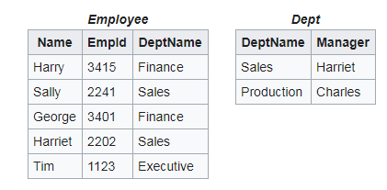
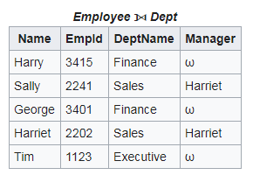
Outer join (Another Example)
Left Outer Join(Employee Department)
Omega or -

Slide 22
Outer join
Right Outer Join(A B)
In the right outer join, operation allows keeping all tuple in the right relation. However, if there is no matching tuple is found in the left relation, then the attributes of the left relation in the join result are filled with null values.

Slide 23
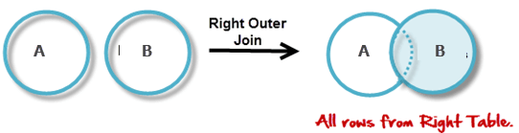
Outer join
Right Outer Join(A B)

Slide 24
Outer join
C
Num | Square
2 | 4
3 | 9
4 | 16
Right Outer Join(A B)
D
Num | Cube
2 | 8
3 | 27
5 | 125
C D
Num | Cube | Square
2 | 8 | 4
3 | 27 | 9
5 | 125 | -

Slide 25
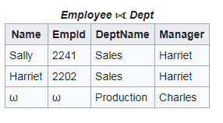
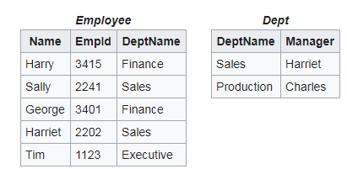
Outer join (Another Example)
Left Outer Join(Employee Department)
Omega or -

Slide 26
Full Outer join (A B)
In a full outer join, all tuples from both relations are included in the result, irrespective of the matching condition

Slide 27
Full Outer join
C
Num | Square
2 | 4
3 | 9
4 | 16
Right Outer Join(A B)
D
Num | Cube
2 | 8
3 | 27
5 | 125
C D
Num | Square | Cube
2 | 4 | 8
3 | 9 | 27
4 | 16 | -
5 | - | 125

Slide 28
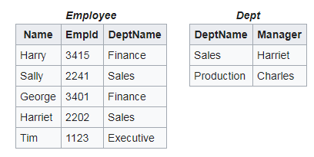
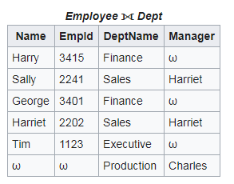
Outer join (Another Example)
Full Outer Join(Employee Department)
Omega or -

Slide 29
Outer Join ( Another Example)
Summary
There are three forms of the outer join, depending on which data is to be kept.
LEFT OUTER JOIN - keep data from the left-hand table
RIGHT OUTER JOIN - keep data from the right- hand table
FULL OUTER JOIN - keep data from both tables

Slide 30
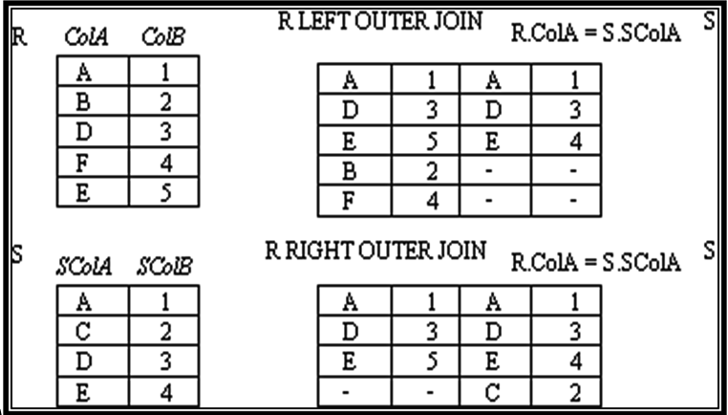
Example: Left/Right outer join
( Another Example)

Slide 31
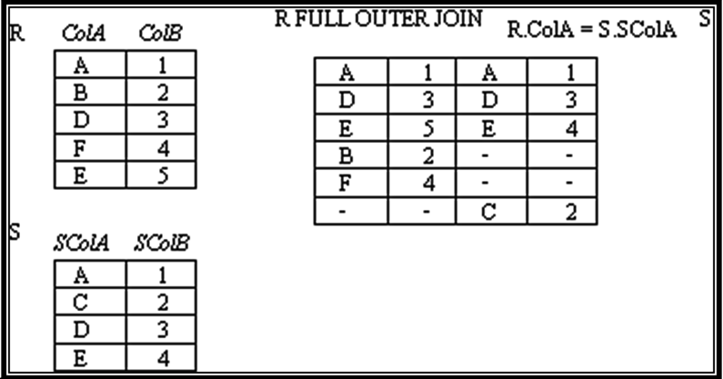
Example: Full outer join
( Another Example)

Slide 32
Thanks

